Slide 1
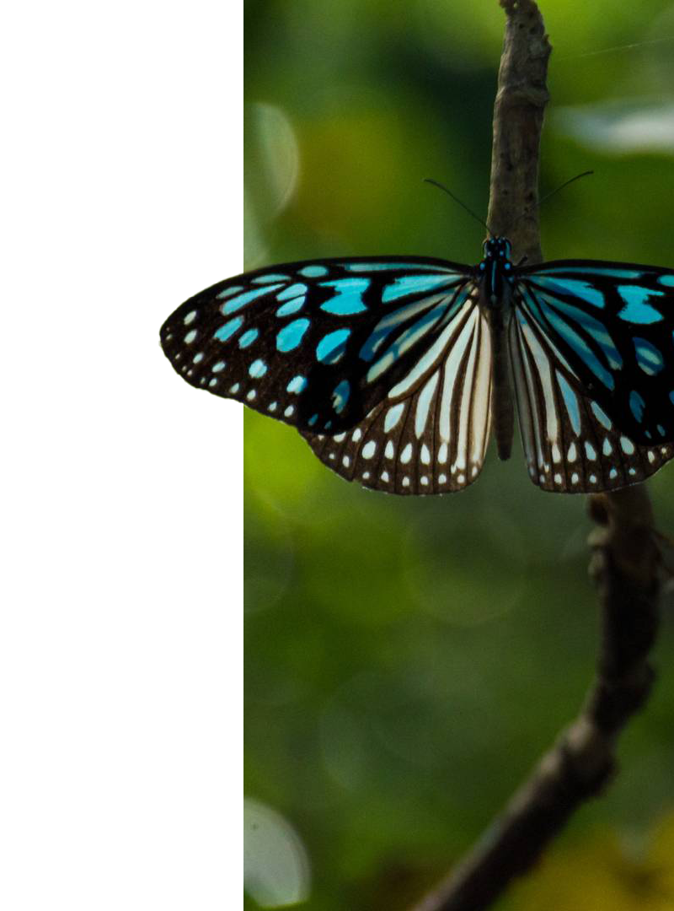
KINGDOMS OF NATURE
Course by Remy Morris
How living things are scientifically classified

Slide 2

course description
In this course, we’ll learn how all living things are classified into one of seven groups (or “kingdoms”) according to their common characteristics.

Slide 3
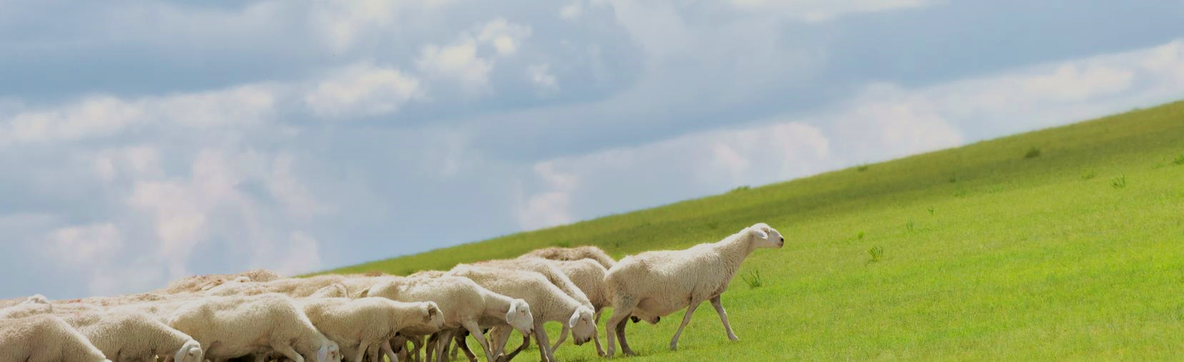
course outline
01
02
03
04
05
Lesson
Lesson
Lesson
Lesson
Lesson
The seven kingdoms of nature
How living things are grouped into kingdoms
Deeper classification (getting to species)
How genetic research impacts classification
The future: beyond the seven kingdoms

Slide 4
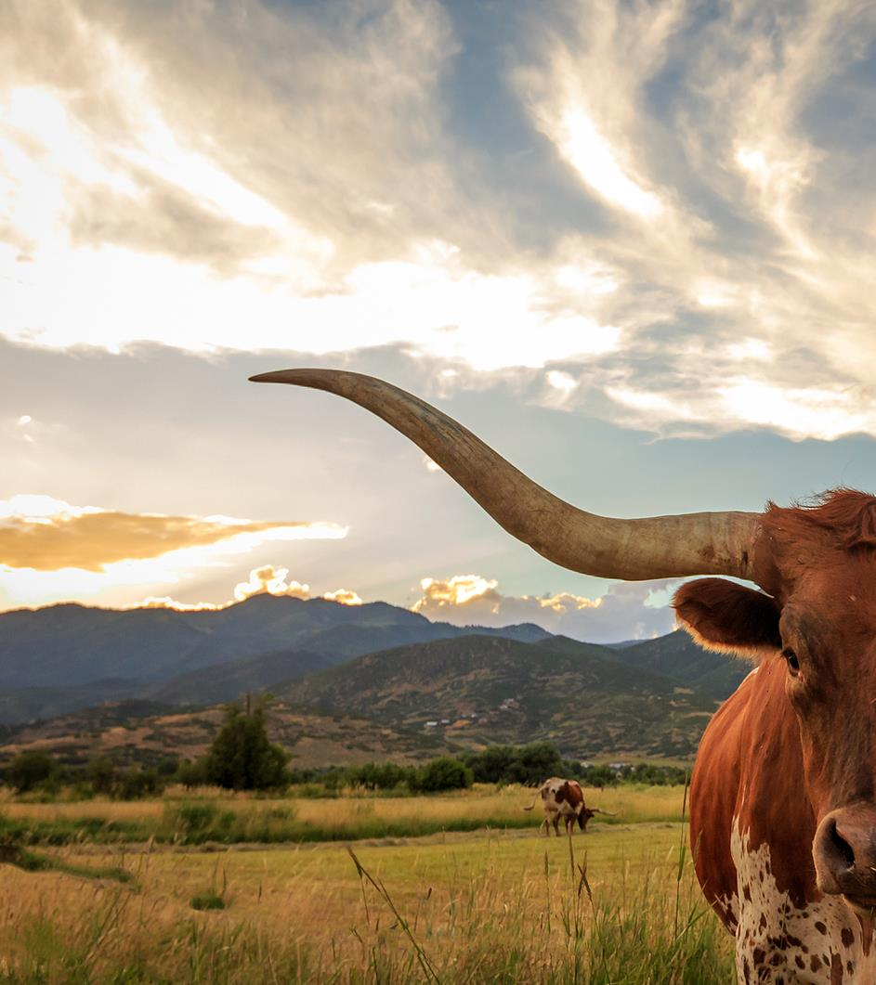
01
lesson
The seven kingdoms of nature

Slide 5
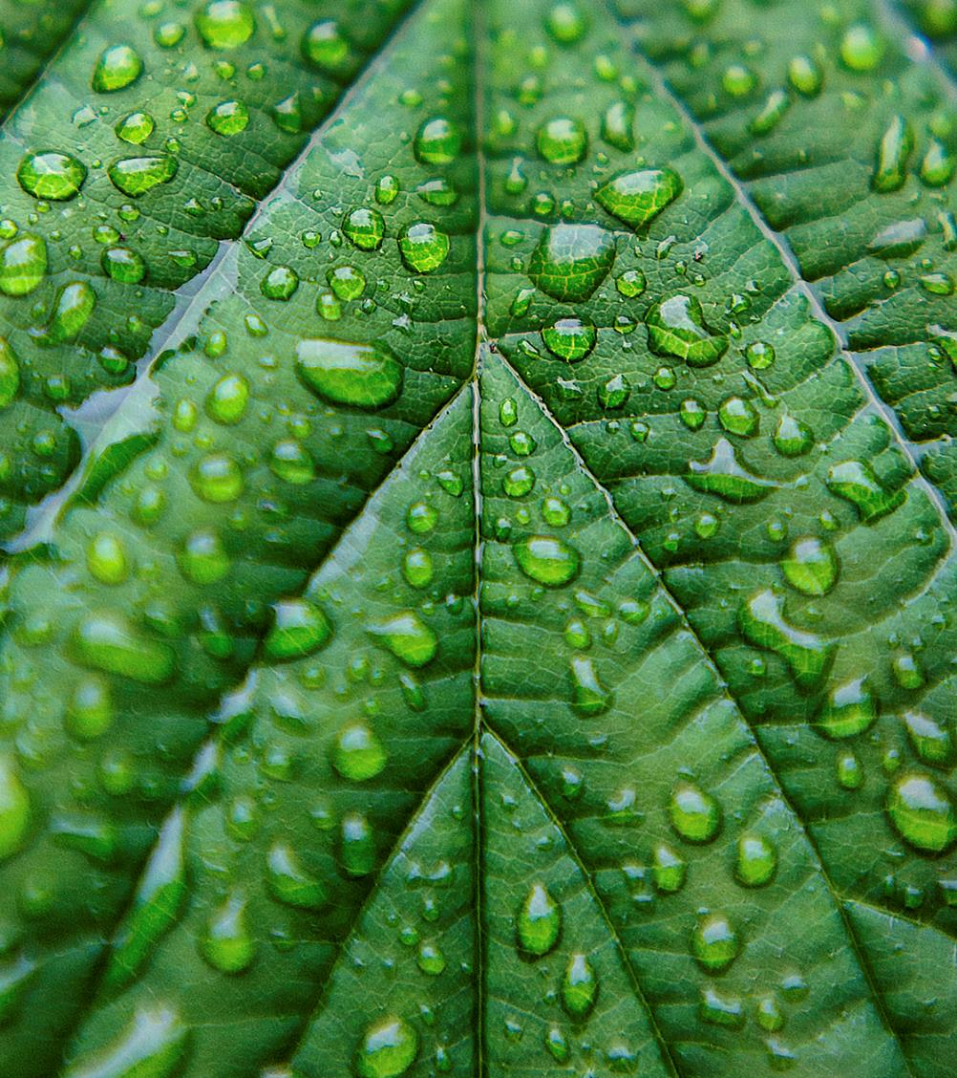
lesson outline
Topic 1: The animal kingdom​
Topic 2: The plant kingdom​
Topic 3: The fungi kingdom​
Topic 4: The chromista & protista kingdoms
​
Topic 5: The bacteria & archaea kingdoms

Slide 6
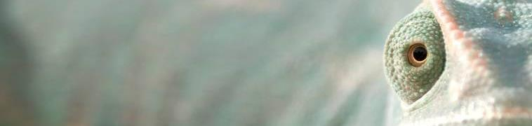
topic 1
The animal kingdom
Animals have these traits in common:​
Multicellular
Heterotrophic
Aerobic
Sexual
Mobile
They have two or more cells
They feed on other living things
They need oxygen to breathe
They need a partner to reproduce
They are able to move from place to place

Slide 7




topic 2
The plant kingdom
Multicellular
Autotrophic
Aerobic
Immobile

Slide 8
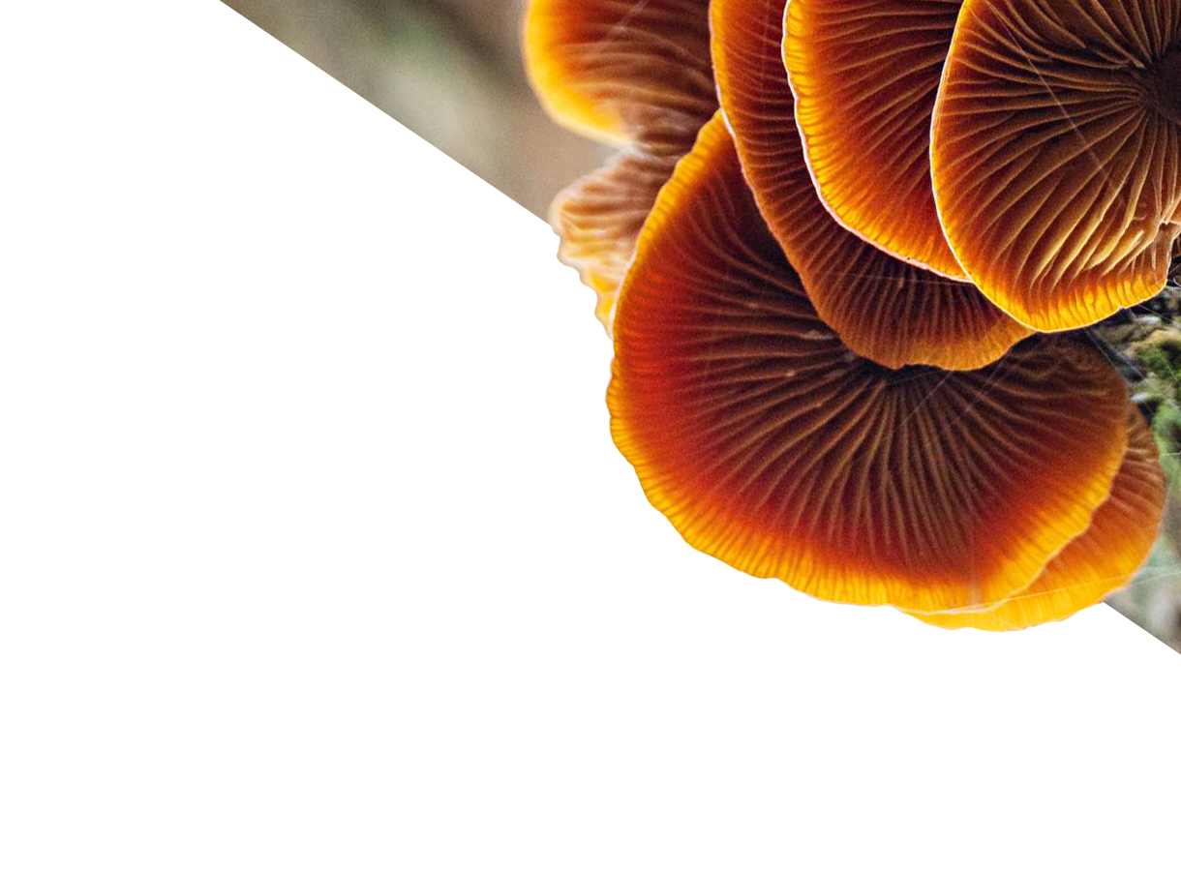
topic 3
The fungi kingdom
Mushrooms + lichen​
Yeasts
Molds
Multicellular
Heterotrophic
Aerobic
Spore reproduction
Unicellular
Eukaryotic
Aerobic
Asexual reproduction through mitosis
Unicellular
Heterotrophic
Aerobic — but can survive extremely low oxygen levels
Spore reproduction

Slide 9

topic 4
Chromista
Includes algae and seaweeds
Either multi- or unicellular
Autotrophic: Creating their own food through photosynthesis
The chromista & protista kingdoms
Protista
Includes amoebas and diatoms
Unicellular
Unable to be classified as an animal, plant, or fungus

Slide 10
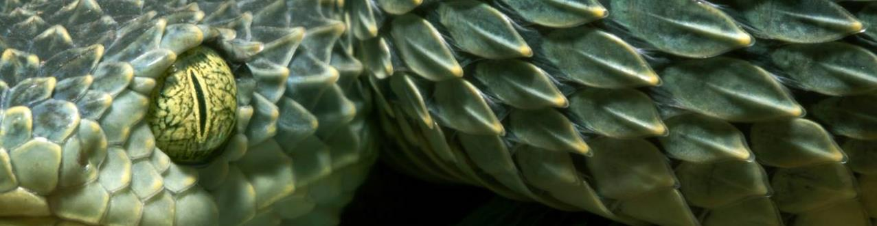
lesson summary
The seven kingdoms of nature are animals (animalia), plants (plantae), fungi, chromista, protozoa, arachea, and bacteria.
The number of recognized kingdoms has grown over time, from 2 in 1735, to 5 in 1969, to 7 in 2015. As we learn more, this number might grow.
Viruses are not currently included in any kingdom of nature.

Slide 11
course progress
 | Lesson 1 | Lesson 2 | Lesson 3 | Lesson 4 | Lesson 5
Reading complete | Jan 7 | Jan 21 | Feb 4 | Feb 18 | March 4
Coursework done | Jan 14 | Jan 28 | Feb 11 | Feb 25 | March 14
Test date | Jan 17 | Jan 31 | Feb 17 | Feb 28 | March 17

Slide 12
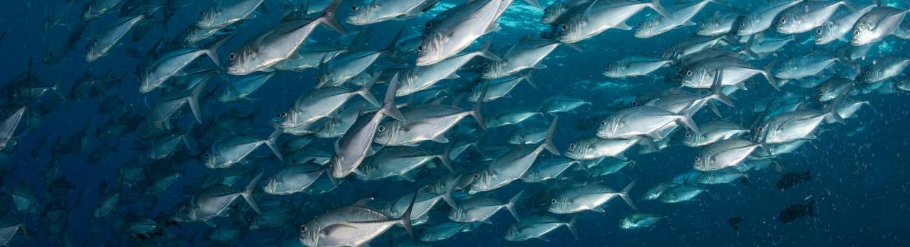
contact info
Remy Morris
206-555-0146
rmorris@contoso.com
www.contoso.com

Slide 13
Python-pptx Presentation
Created with python-pptx

Slide 14
Slide 1
This is the content of slide 1.
This is the second line.

Slide 15
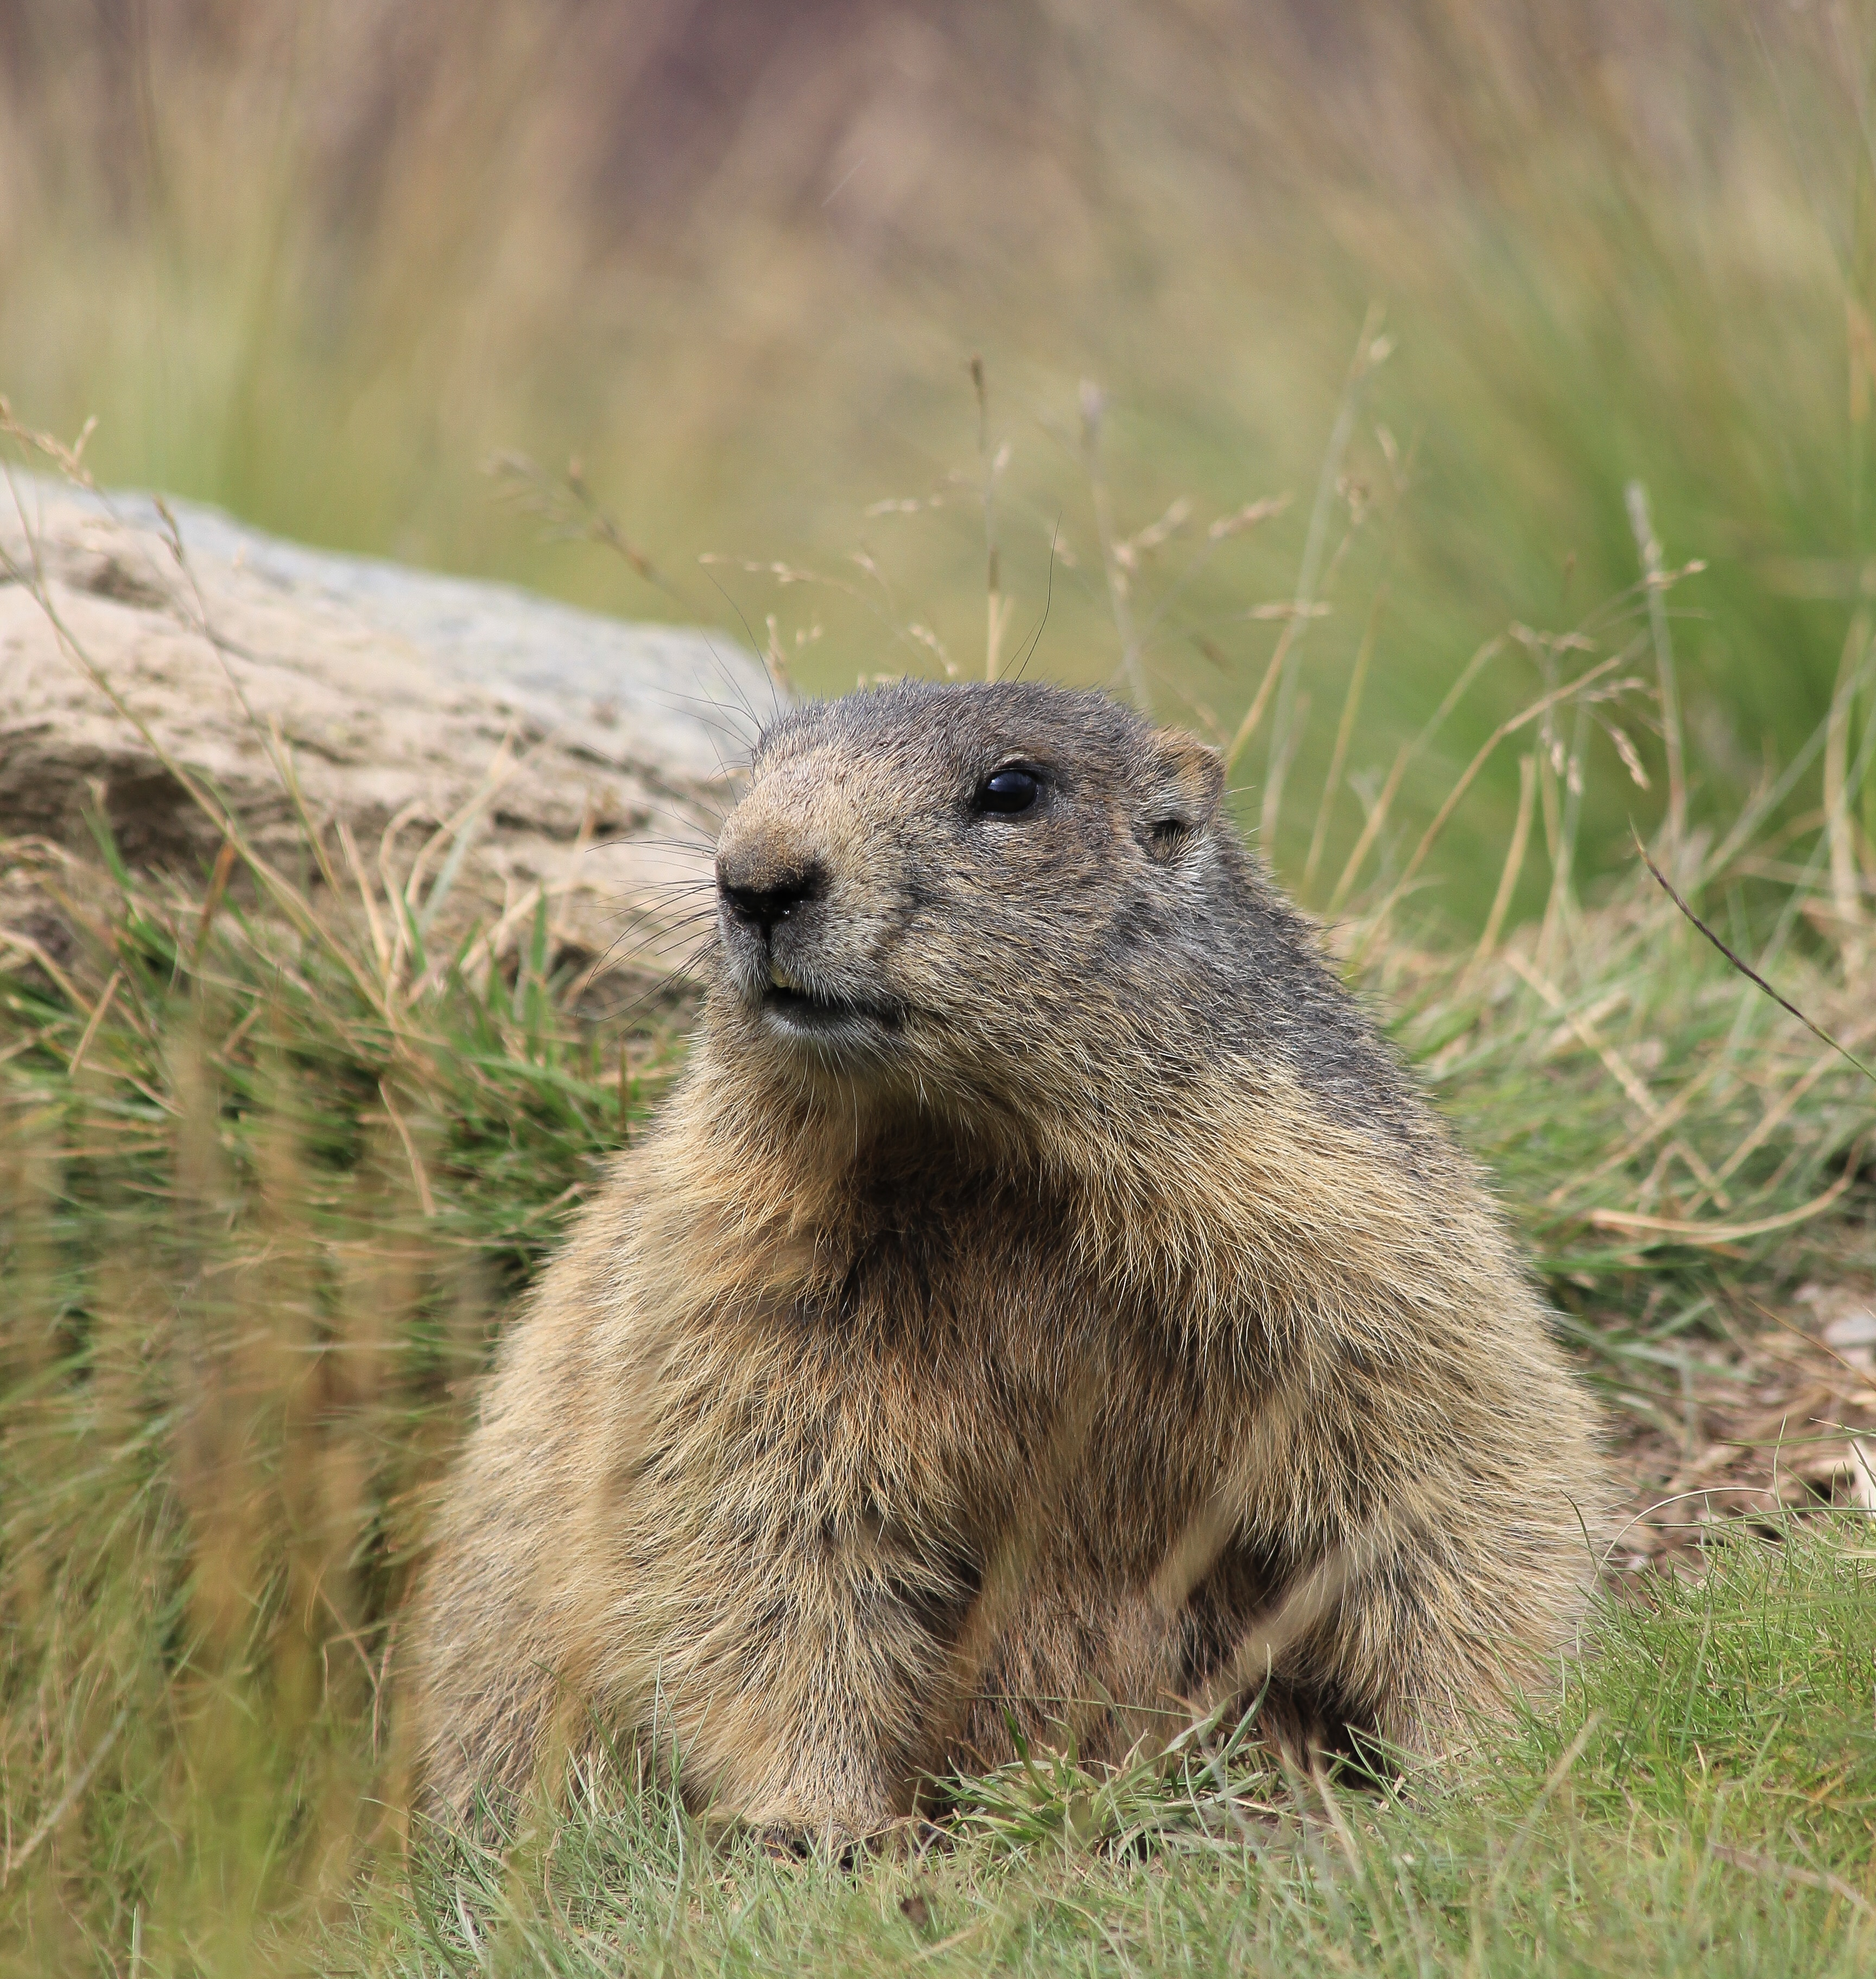
Slide 2
I am a marmot
This Marmot is writing

